Slide 1

Chapter: CPU/ Process Scheduling

Slide 2
Priority Scheduling
Priority is associated with each process.
CPU is allocated to the process with highest priority.
If 2 processes have same priority → FCFS
Disadvantage: Starvation (Low priority Processes wait for long)
Solution of Starvation: Aging
Aging: Priority of process is increased gradually (e.g after every 5 min priority is incremented by 1)

Slide 3
Priority Scheduling (Preemptive)
Process | Arrival Time | Priority | Burst Time | Completion Time
P1 | 1 | 5 | 4
P2 | 2 | 7 | 2
P3 | 3 | 4 | 3
Consider 4 as Highest and 7 as Lowest Priority0

Slide 4
Priority Scheduling (Preemptive)
Process | Arrival Time | Priority | Burst Time | Completion Time
P1 | 0 | 2 | 10
P2 | 2 | 1 | 5
P3 | 3 | 0 | 2
P4 | 5 | 3 | 20
Consider 3 as Lowest and 0 as Highest Priority

Slide 5
H.W: Priority Scheduling (Preemptive)
Process | Arrival Time | Priority | Burst Time | Completion Time
P1 | 1 | 4 | 4
P2 | 2 | 5 | 2
P3 | 2 | 7 | 3
P4 | 3 | 8 | 5
P5 | 3 | 5 | 1
P6 | 4 | 6 | 2
Consider 4 as Lowest and 8 as Highest Priority

Slide 6
Priority Scheduling (Preemptive)
Process | Arrival Time | Priority | Burst Time | Completion Time
P1 | 1 | 2 | 4
P2 | 1 | 2 | 2
P3 | 2 | 10 | 5
P4 | 3 | 6 | 3
Consider 2 as Lowest and 10 as Highest Priority

Slide 7
H.W: Priority Scheduling (Preemptive)
Process | Arrival Time | Priority | Burst Time | Completion Time
P1 | 0 | 2 | 4
P2 | 1 | 4 | 2
P3 | 2 | 6 | 3
P4 | 3 | 10 | 5
P5 | 4 | 8 | 1
P6 | 5 | 12 | 4
P7 | 6 | 9 | 6
Consider 2 as Lowest and 12 as Highest Priority

Slide 8
Priority Scheduling (Non-Preemptive)
Process | Arrival Time | Priority | Burst Time | Completion Time
P1 | 0 | 4 | 4
P2 | 1 | 5 | 5
P3 | 2 | 7 | 1
P4 | 3 | 2 | 2
P5 | 4 | 1 | 3
P6 | 5 | 6 | 6
Consider 7 as Lowest and 1 as Highest Priority

Slide 10
Round Robin Scheduling
A Time Quantum is associated to all processes
Time Quantum: Maximum amount of time for which process can run once it is scheduled.
RR scheduling is always Pre-emptive.

Slide 11
Round Robin
TQ: 2
Process | Arrival Time | Burst Time | Completion Time
P1 | 0 | 5
P2 | 1 | 7
P3 | 2 | 1
Process | Arrival Time | Burst Time | Completion Time
P1 | 0 | 3
P2 | 3 | 4
P3 | 4 | 6

Slide 13
Round Robin
TQ: 2
Process | Arrival Time | Burst Time | Completion Time
P1 | 0 | 4 | 8
P2 | 1 | 5 | 18
P3 | 2 | 2 | 6
P4 | 3 | 1 | 9
P5 | 4 | 6 | 21
P6 | 6 | 3 | 19

Slide 14
Round Robin
TQ: 2
Process | Arrival Time | Burst Time | Completion Time
P1 | 0 | 4 | 8
P2 | 1 | 5 | 18
P3 | 2 | 2 | 6
P4 | 3 | 1 | 9
P5 | 4 | 6 | 21
P6 | 6 | 3 | 19
RQ: P1 P2 P3 P1 P4 P5 P2 P6 P5 P2 P6 P5

Slide 15
Multilevel Queue
A multilevel queue scheduling algorithm partitions the ready queue into several separate queues.
For Example: a multilevel queue scheduling algorithm with five queues, listed below in order of priority:
1. System processes
2. Interactive processes
3. Interactive editing processes
4. Batch processes
5. Student/ user processes

Slide 16
Multilevel Queue
A process can move between various queues
Multilevel Queue Scheduler defined by the following parameters:
  No. of queues
  Scheduling algorithms for each queue
  Method used to determine when to upgrade / demote a process
  Method used to determine which queue a process will enter and when that process needs service.

Slide 17
Multilevel Queue
Example:
No process in the batch queue, could run unless the queues for system processes, interactive processes, and interactive editing processes were all empty.
If an interactive editing process entered the ready queue while a batch process was running, the batch process would be preempted.

Slide 18
Multilevel Queue
Processes can be :
  Foreground Process: processes that are running currently → RR Scheduling is applied
  Background Process: Processes that are running in the background but its effects are not visible to user. →FCFS
Multilevel queue scheduling divides ready queue into several queues.
Processes are permanently assigned to one queue on some property like memory size, process priority, process type.
Each queue has its own scheduling algorithm

Slide 19
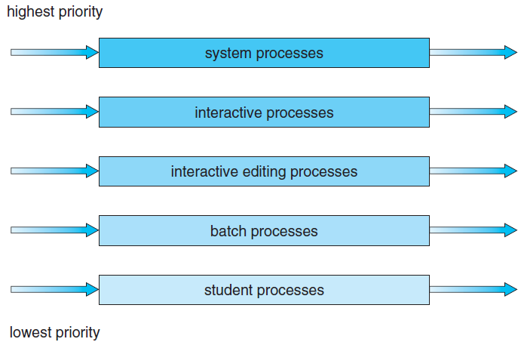
Multilevel Queue

Slide 20
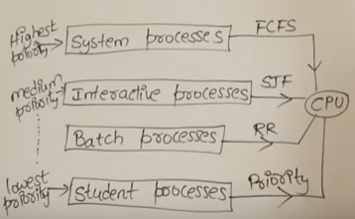
Multilevel Queue

Slide 21
Multilevel Queue
System Processes: These are programs that belong to OS (System Files)
2. Interactive Processes: Real Time Processes e.g. playing game online, listening to music online etc.
3. Batch Processes: Lots of processes are pooled and one process at a time is selected for execution. I/O by Punch Cards
4. Student/User Processes

Slide 22
Multilevel Queue
As different type of processes are there so all cant be put into same queue and apply same scheduling algorithm.
Disadvantages:
Until high priority queue is not empty, No process from lower priority queues will be selected.
Starvation for lower priority processes
Advantage:
Can apply separate scheduling algorithm for each queue.

Slide 23
Practice: Multilevel Queue
Process | Arrival Time | Burst Time | Queue
P1 | 0 | 4 | 1
P2 | 0 | 3 | 1
P3 | 0 | 8 | 2
P4 | 10 | 5 | 1
Priority of queue 1 is greater than queue 2. queue 1 uses Round Robin (Time Quantum = 2) and queue 2 uses FCFS.

Slide 24


